Slide 1
Feminist criticism
DR. LILY MONDAL
Asstt. Professor
Hooghly Women’s College
Hooghly,West Bengal

Slide 2
Subjugation of Women
In the history of human race the nineteenth and twentieth centuries have been most remarkable in the lives of women for these two centuries have drastically changed and shaped their lives all over the world.
One of the leading concerns of these centuries in the world is the subjugation of women.
Women seen as the ‘Other’ have come forward to remove the stigma of womanhood enforced on them.

Slide 3
Right to Vote for English Women
The striving for equality was voiced forth first by the working-class women in their demand for equality of wage.
Gradually the urge for equality spread out in the higher classes too. In 1928 English women got the right to vote.
This alone shows that women have been denied equality until recently.

Slide 4
Virginia Woolf
Though the history of women suffrage dates long back, the patriarchal notions and ideologies were challenged most frequently in the twentieth century.
Virginia Woolf published A Room of One’s Own in 1929 and described how women are socially and physically dominated by men.
She argued that the patriarchal society denied space to women generating gender inequality. Woolf reacted vehemently how women were considered as ‘looking glass’ by men and are regarded as the ‘Other’.

Slide 5
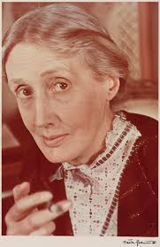
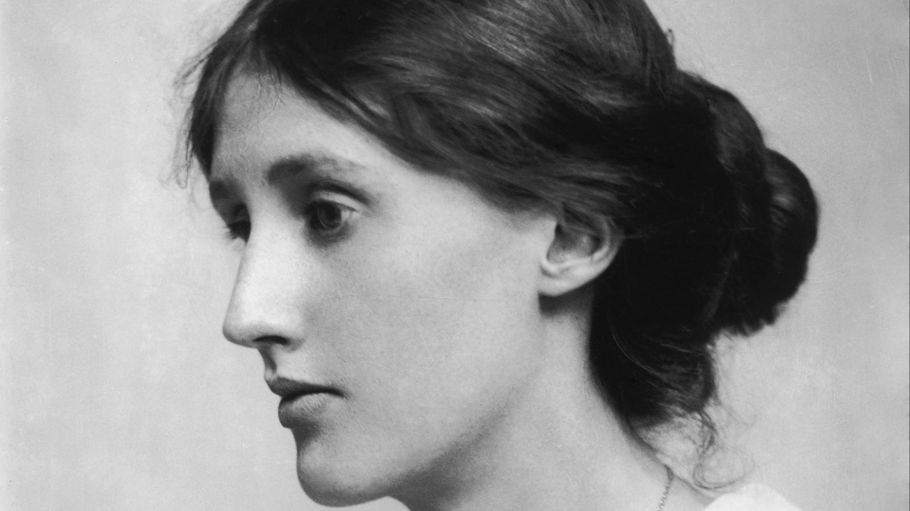
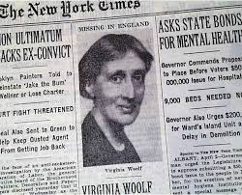
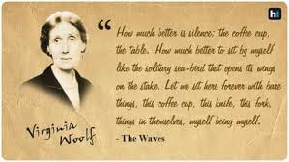

Slide 6
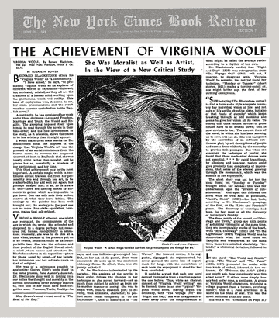

Slide 7
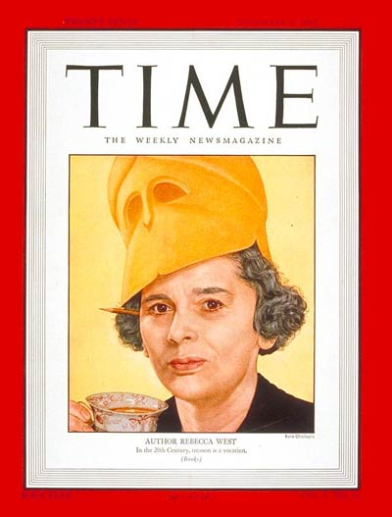
Rebecca West
Rebecca West analysed the features of male power and reacted strongly against economic exploitations of working-class women.

Slide 8
Simone de Beauvoir
Simone de Beauvoir made outstanding contribution to feminism through her The Second Sex in 1949.
Her opinion that women are viewed in the society as the ‘second sex’ or the ‘Other’ is analogous to what Woolf said that woman is seen in the society as mirror.
Beauvoir said ‘one is not born but rather becomes a woman’.
She explained how women have been given an inferior position in the male/female binary among such others as culture/nature; production/reproduction etc.

Slide 9
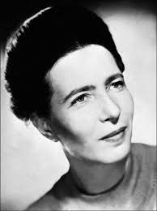
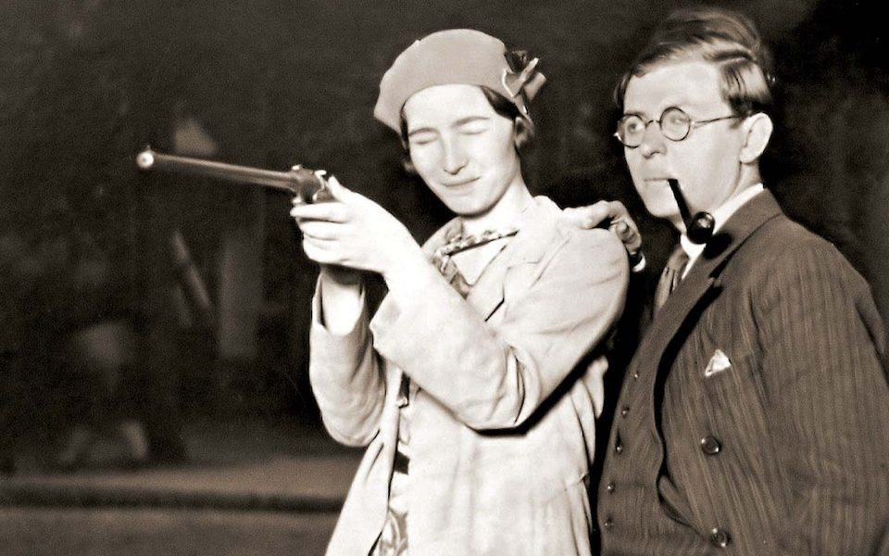
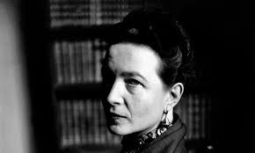
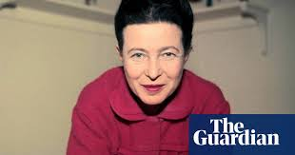
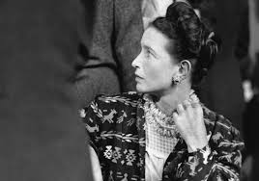

Slide 10
Kate Millett
Katherine Murray Millett was an American feminist writer, educator, artist, and activist. She attended Oxford University and was the first American woman to be awarded a degree with first-class honors after studying at St Hilda's College, Oxford.
Kate Millett’s ‘Sexual Politics’ (1970) argued that ideological indoctrination and economic inequality are the causes of women’s oppression.

Slide 11
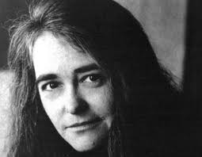
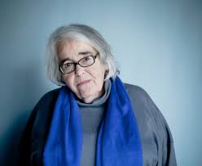
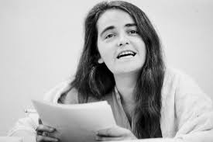

Slide 12
The above discussion shows how women outside India fought for their rights and how they are trying to achieve equality in the male-dominated society.

